Slide 1
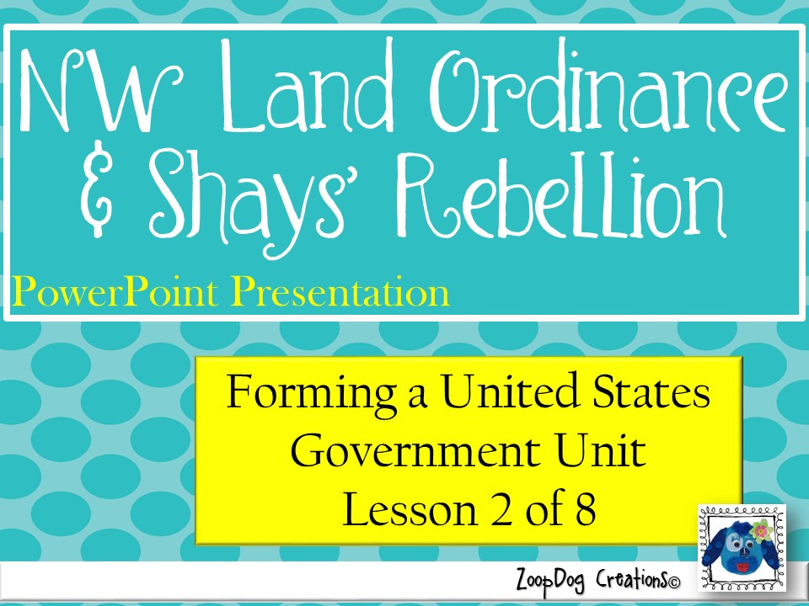

Slide 2
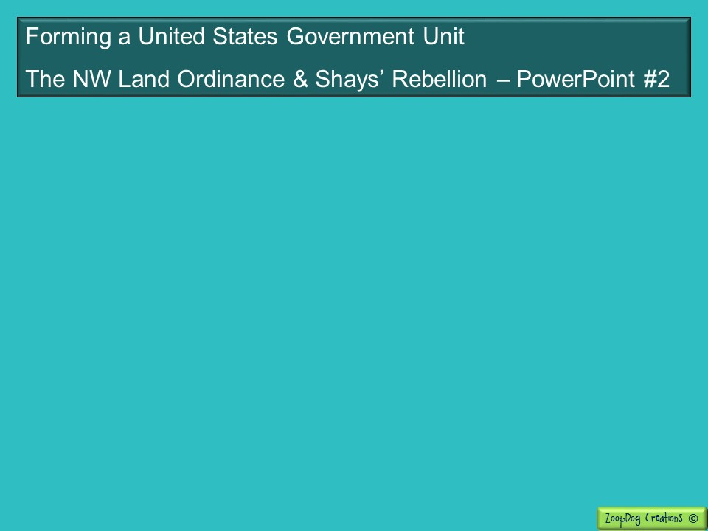
VOCABULARY Land Ordinance of 1785 – Debt – Northwest Ordinance – Economic Depression – Shays’ Rebellion –

Slide 3
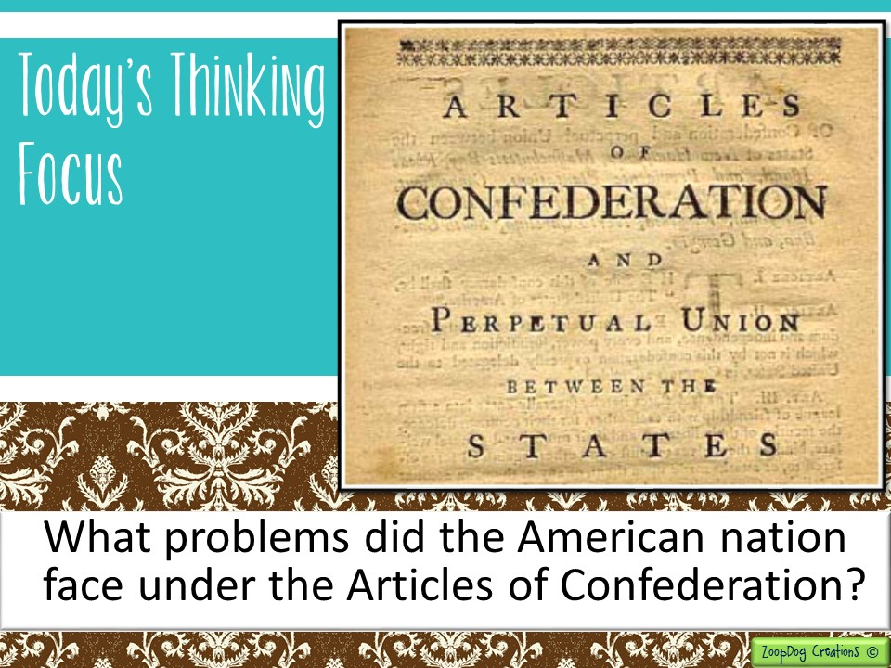

Slide 4

And the story continues . . .
British general Cornwallis surrenders, the Revolutionary War is over!
In 1776, the states began forming their own governments, while the Continental Congress began drafting plans for the nation as a whole.
The Continental Congress creates the Articles of Confederation –a weak constitution giving the states all the power!

Slide 5
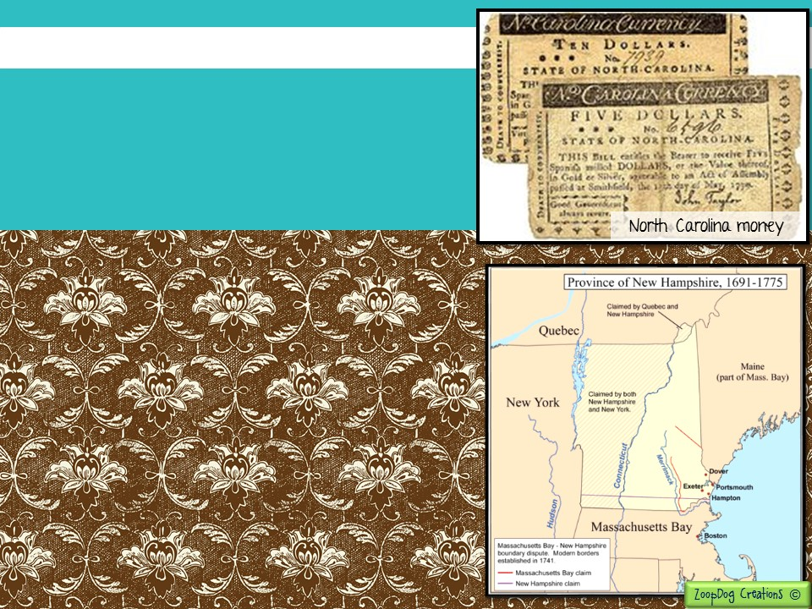
Despite its weakness, the Articles were not an unsuccessful first attempt at government.
If the states could have put aside their differences and worked together the new government may have worked. Instead . . .
New Hampshire and New York both claimed the land called Vermont.
Most states refused to accept the money of other states.
The Articles of Confederation did not provide a way for states to settle their disputes with one another!

Slide 6
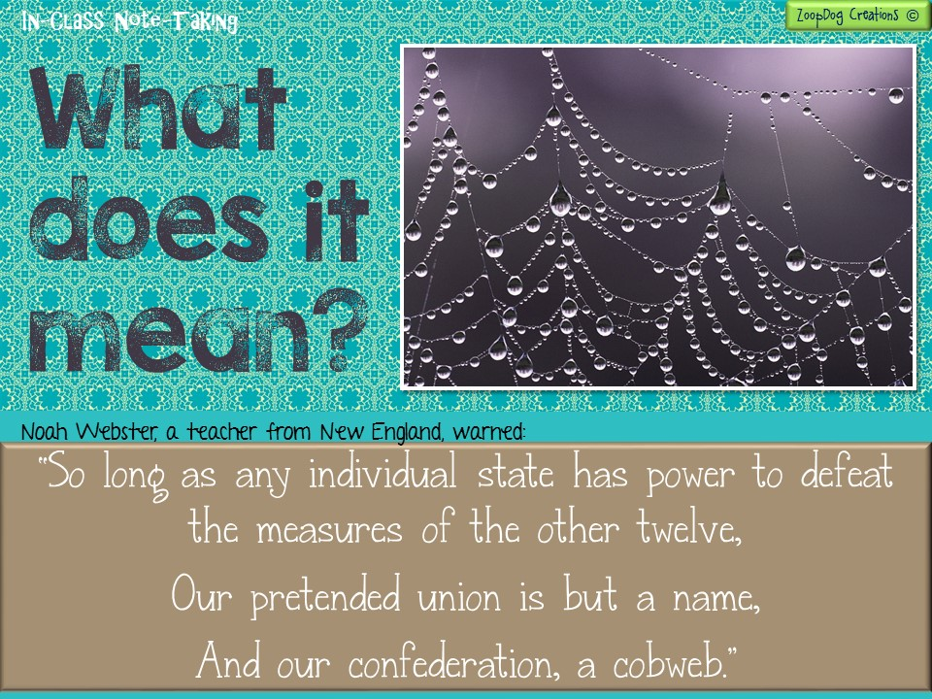

Slide 7
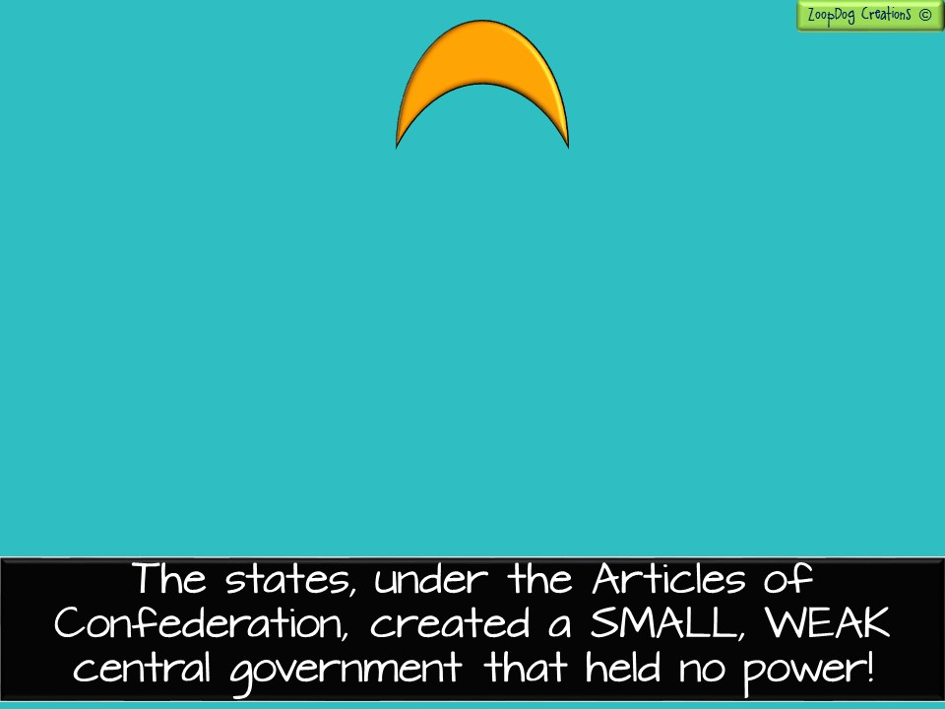
Small Central Government
The political authority which governs over the states.
States
States
States
States
States
States
States
States
States
States
States
States
States

Slide 8
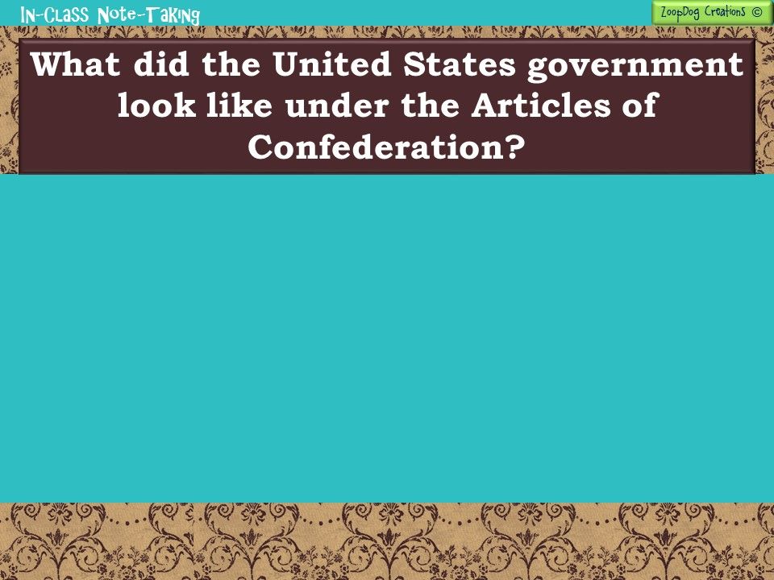
The United States government (Congress) could . . .
The United States government (Congress) could NOT . . .
Declare war on other countries.
Appoint military officers.
Coin money (so could the states).
Maintain relationships with foreign countries.
Pass laws (9 of the 13 states had to approve the law to make it official).
Congress could not regulate trade between states and foreign countries.
It could not pass tax laws.
To raise money, Congress had to ask the states for it! However, no state could be forced to give money.
The Articles limited the power of the United States Congress and preserved the powers of the states.

Slide 9
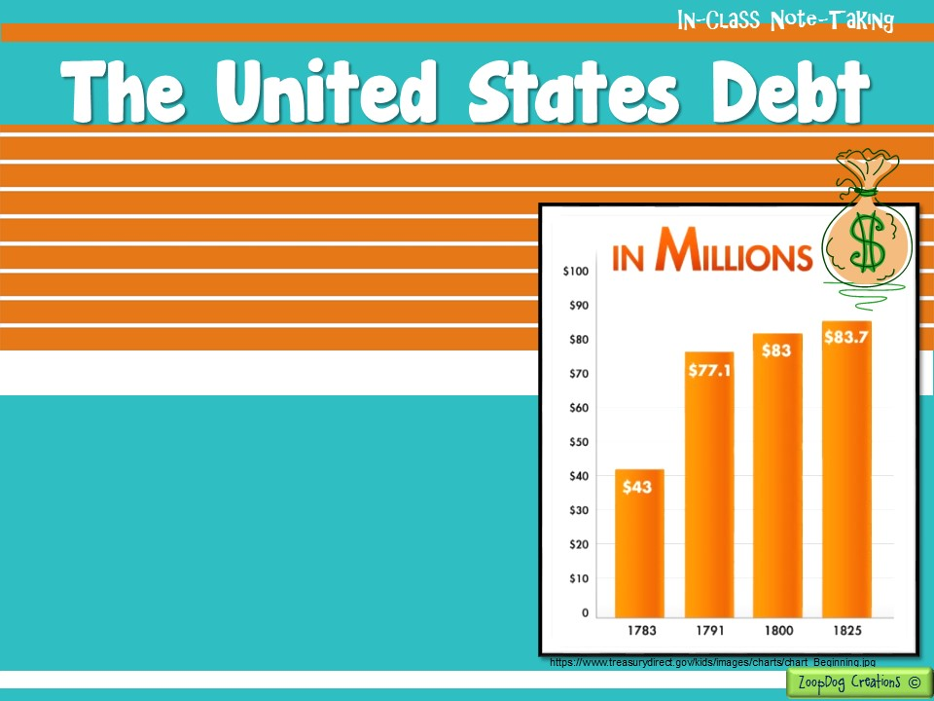
The thirteen colonies had borrowed A LOT of money during the Revolutionary War and they owed a debt - millions of dollars to individuals and foreign nations.
Since Congress (Federal government) did not have the power to tax individuals or states, it had no way of repaying these debts.
Congress asked the states for money, but the states could refuse which they did most of the time!

Slide 10
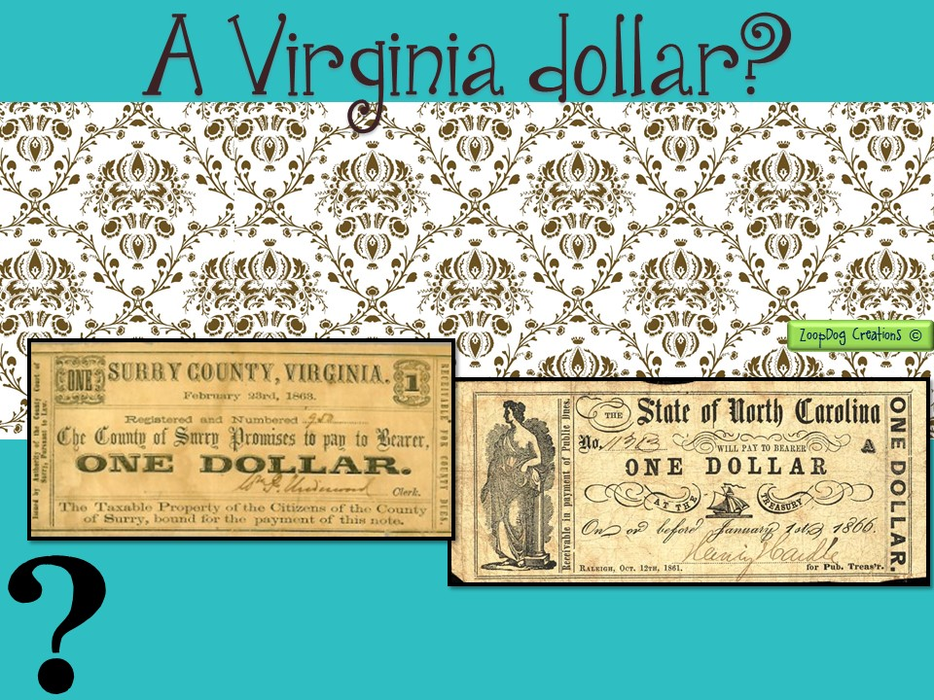
States began to print their own money which caused a lot of CONFUSION!!
Trade between the states became difficult since one state dollar could be worth more or less than another state dollar!
Could you use a New York dollar in Pennsylvania?
Was a Virginia dollar as valuable as a Maryland dollar?

Slide 11
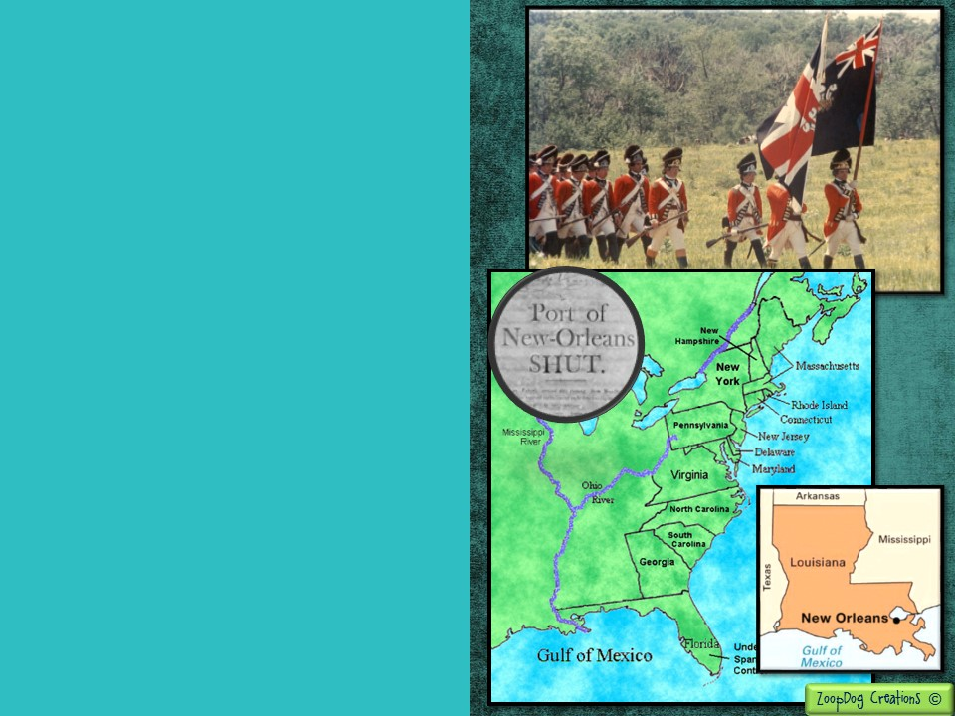
Other nations could see the new American government was weak. They began to take advantages of the situation.
Britain refused to withdraw its troops from the Ohio River Valley as it had agreed to do in the Treaty of Paris.
Spain closed its port in New Orleans to American farmers.
This was a serious disaster to western farmers, who desperately relied on the port to transport their products to the east!

Slide 12
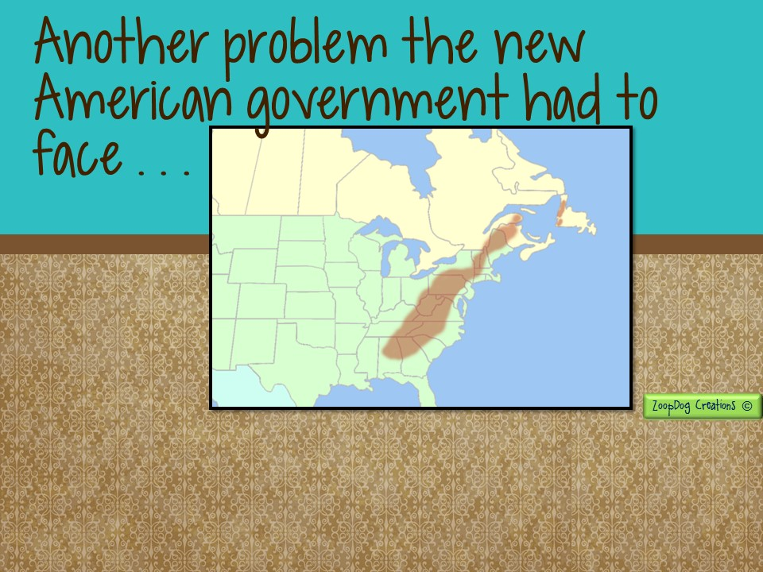
Appalachian Mountains
If Americans start moving across the Appalachian Mountains won’t they eventually need to create new states?

Slide 13
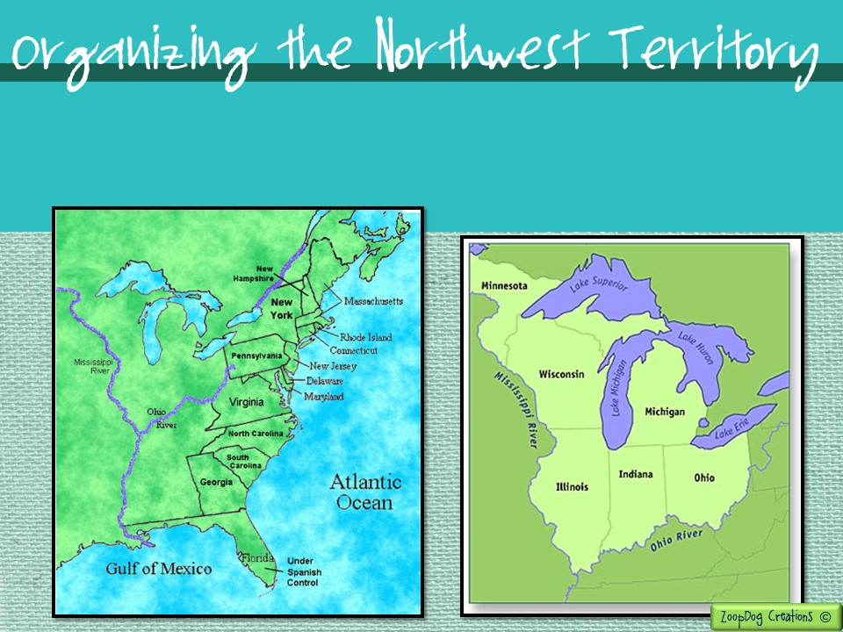
Even though the American Congress was WEAK, it was able to convince the states to pass some important laws involving the Northwest Territory - land east of the Mississippi River.

Slide 14
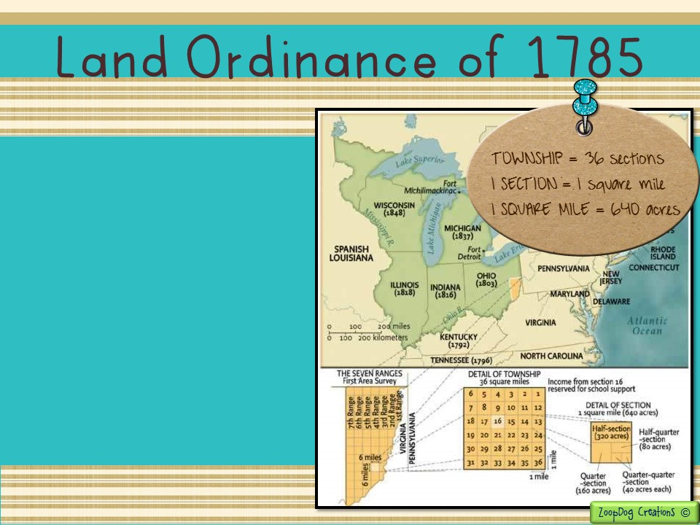
The land ordinance of 1785 set up a system for surveying and settling the Northwest Territory.
The law called for territory to be surveyed and then divided into townships.
Congress planned to sell each section that could be settled for $640.00.
One section in every township was set aside to support public schools.

Slide 15
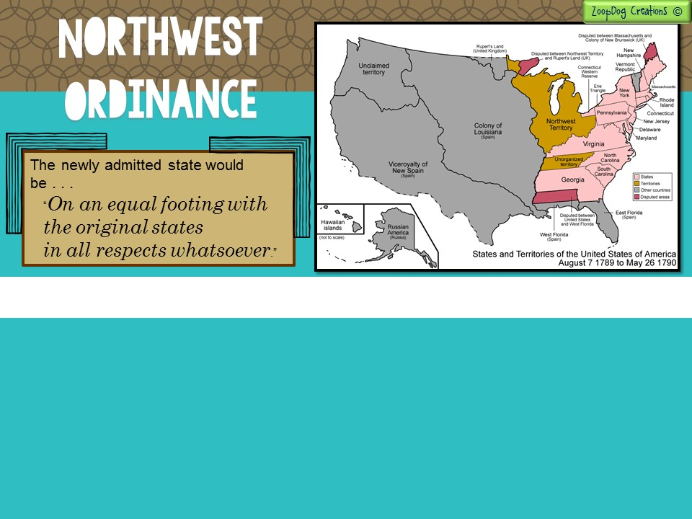
Another law passed in 1787 was called the Northwest Ordinance.
  It set up a government in the Northwest Territory guaranteeing basic rights to settlers.
  No slavery was allowed in the Northwest Territory.
  Once the territory had 60,000 free settlers, it could ask Congress to be admitted as a new state.

Slide 16
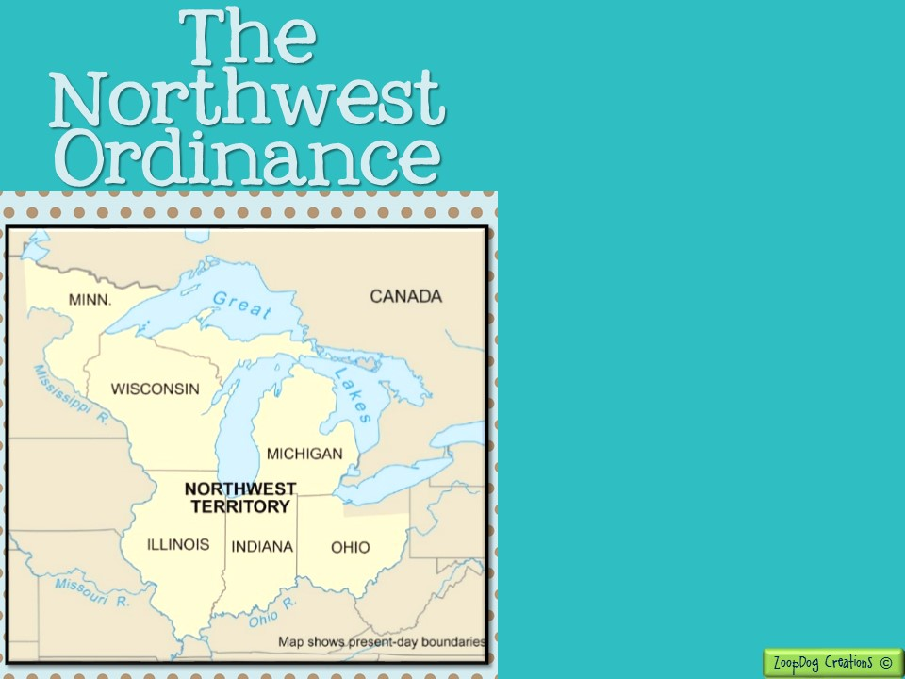
The Northwest Ordinance was one of the successes of the national government under the Articles of Confederation.
It provided a way to admit new states into the Union.
It guaranteed that the new states could be treated the same as the original thirteen states.
In time, states like Ohio, Indiana, Illinois, Michigan, and Wisconsin were created from the Northwest Territory.

Slide 17
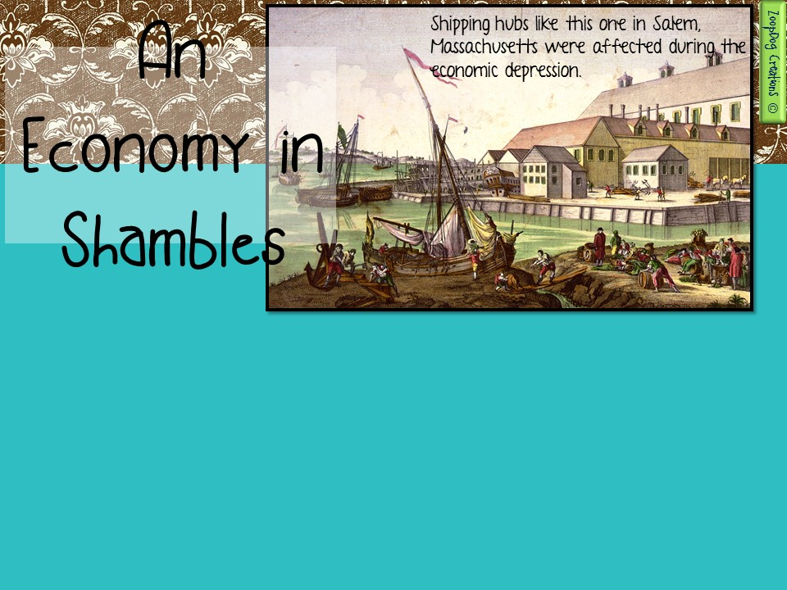
When the Revolutionary War ended in 1781, the United States economy was in ruin.
The newly created American federal government had not been given any power to collect taxes or money from citizens.
It was up to individual states to give money to the federal government to pay off America’s war debt owed to other countries.
Most states, already suffering economically from the war, refused to give money to the government.

Slide 18
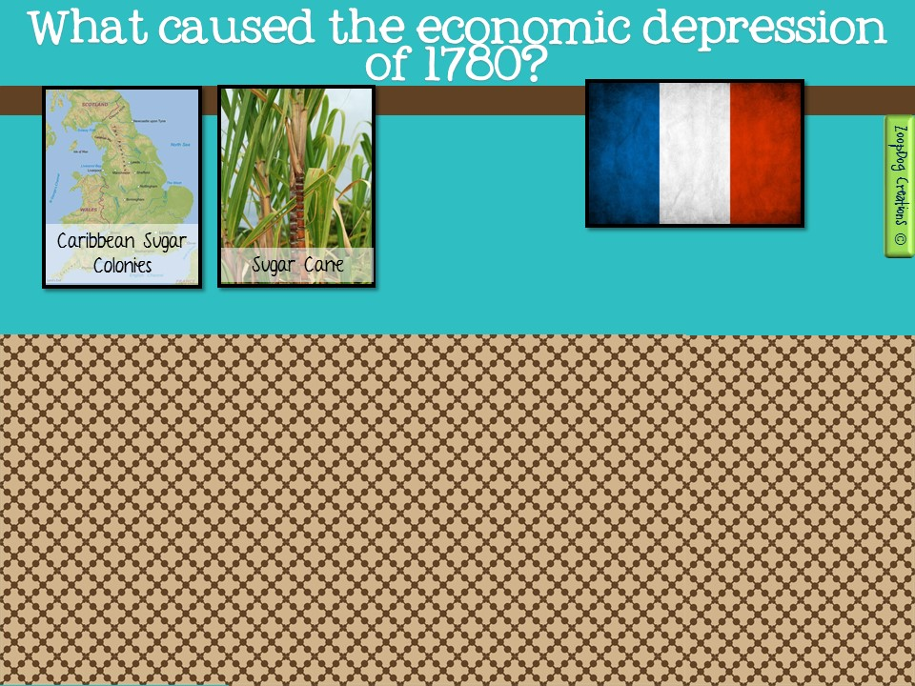
DEBT = NO MONEY
NO TRADE = NO MONEY
The United States borrowed a lot of money from other countries.
It now had to pay that money back, but the weak American government had no way of raising money!
Countries began to take advantage of the failing United States.
Britain imposed many restrictions on the states to punish the new country.
It would allow the states to sell very few goods in England.
England wouldn’t allow the states to trade with its sugar colonies in the Caribbean.

Slide 19
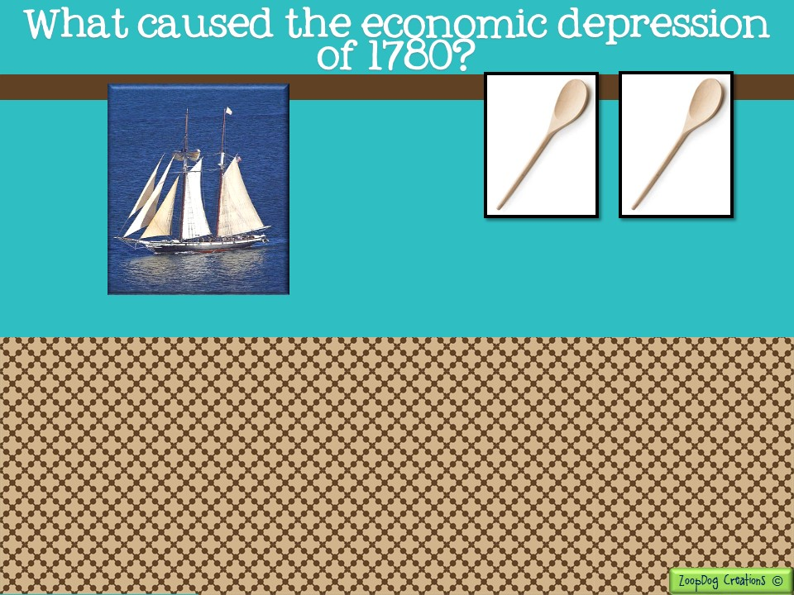
English made
10 cents
American made
20 cents
NOT BUYING AMERICAN MADE GOODS =
NO MONEY
NO SHIPS = NO MONEY
The British navy had destroyed most American ships, making it difficult for the states to trade across the ocean with other countries.
Britain sold its goods in America cheaper than the comparable American-made goods.

Slide 20
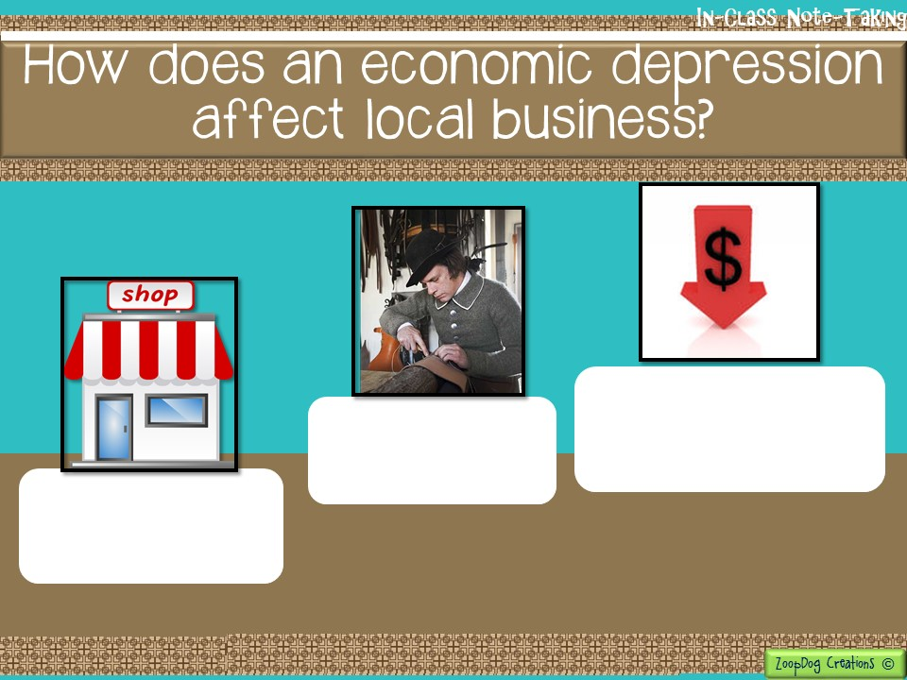
Businesses eventually close because they can’t afford to pay their workers which leads to many people out of work (employment).
Workers earn less money because they sell less goods.
Business slows because customers have less money to shop.

Slide 21
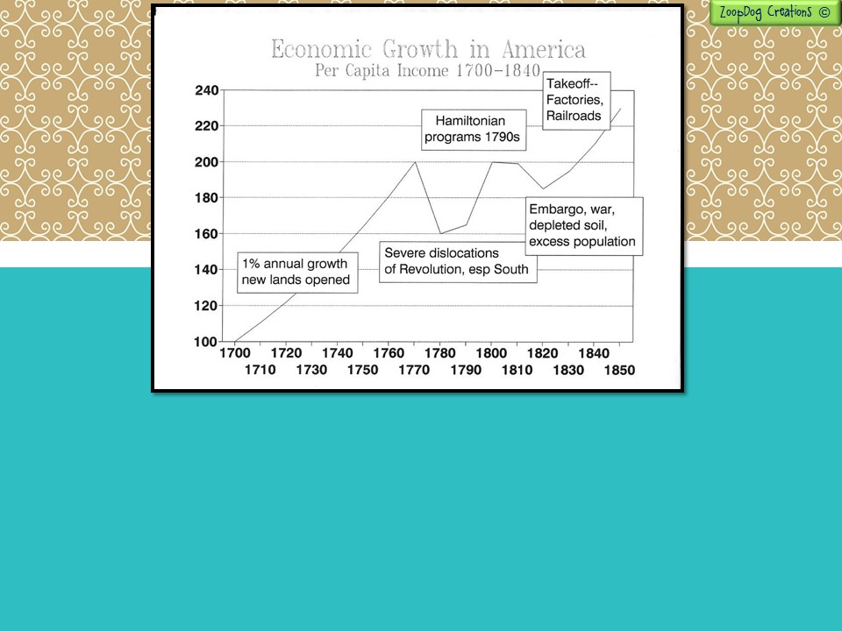
While the American Congress dealt successfully with the Northwest Territory, it was less successful in dealing with its economic (money) problems.
After the Revolutionary War, the United States slipped into an economic depression – a period when business slows, prices and wages fall, and unemployment rises.

Slide 22
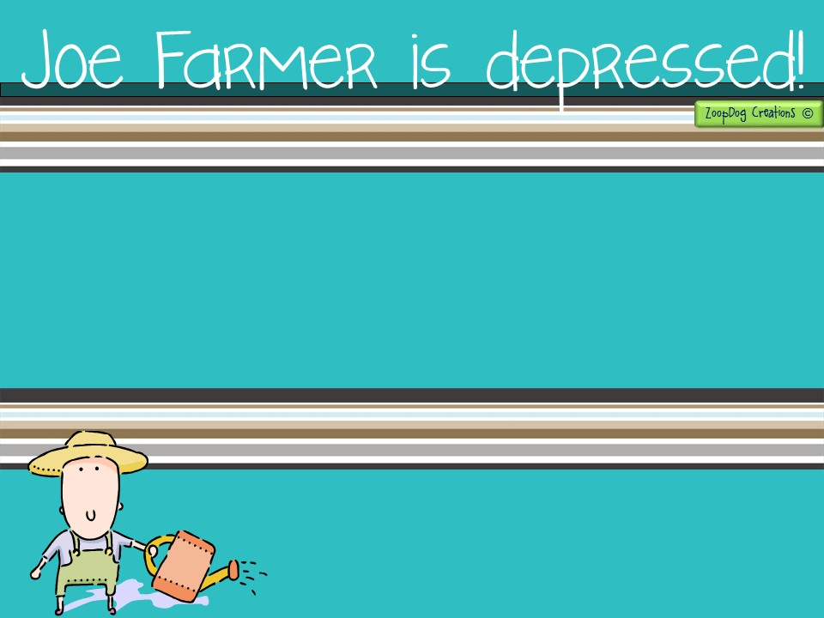
The depression hit farmers hard. During the Revolution there had been a high demand for farm products.
To increase production farmers had borrowed money for land, seed, animals, and tools.
But when the war ended and soldiers returned home, demand for farm goods weakened.
Prices fell, and many farmers could not repay their loans.
Lets use the example of Joe Farmer’s situation to explain what we mean by an economic depression.

Slide 23
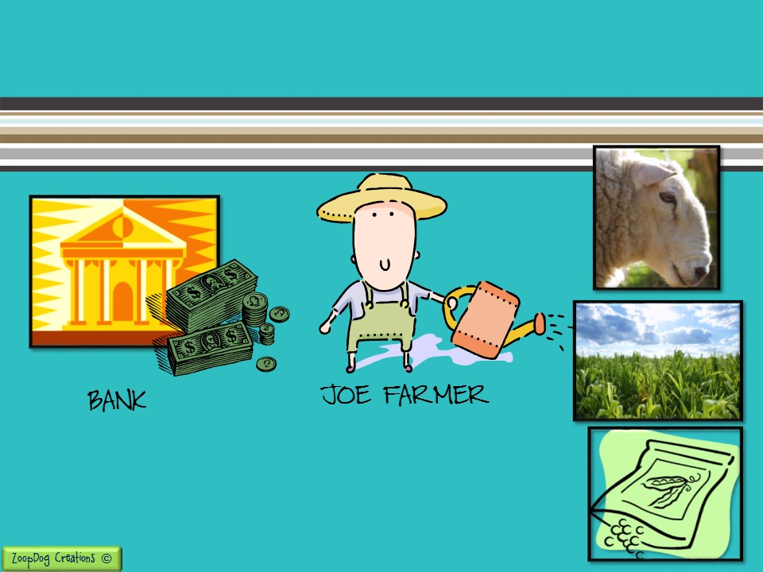
During the American Revolution – meat, and crops are needed to feed the soldiers. The U.S. has money (borrowed from other countries) and can pay merchants and farmers for what it needs. Business is VERY GOOD for Joe Farmer!
Bank gives Joe a loan so he can buy things needed for his farm.
Takes out loans from the bank to buy more land, seed, and livestock because business is good during the war! Joe is making a lot of money!

Slide 24
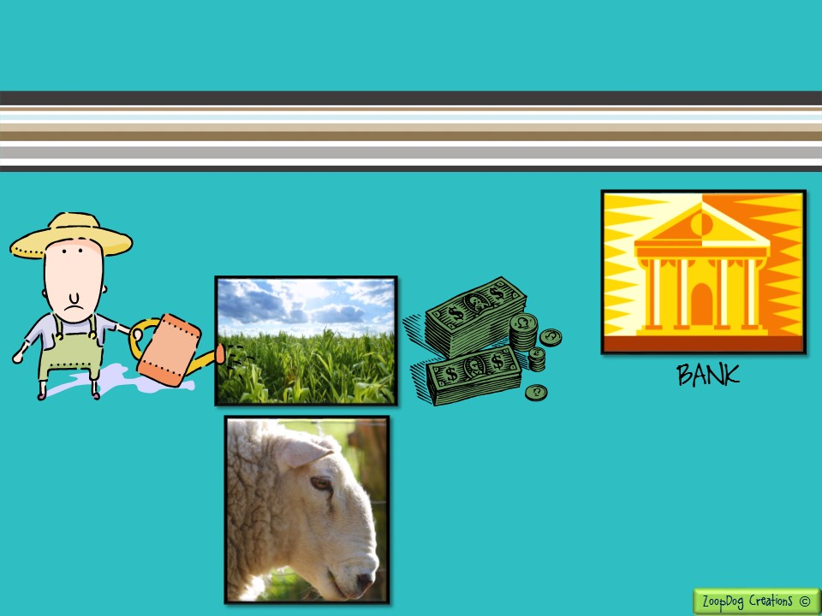
The war is over and business slows down. The U.S. government has to pay back what it borrowed, less money is going into the economy, Joe isn’t making as much money anymore! Business is BAD for Joe Farmer.
Joe receives less money when he sells his crops and livestock!
The bank doesn’t care that Joe isn’t selling his crops and livestock. Joe still has to pay the bank each month for the loan he took out.
The bank tells Joe if he doesn’t pay what he owes they will come and take his farm away.
Joe isn’t making enough money to pay the bank each month.

Slide 25
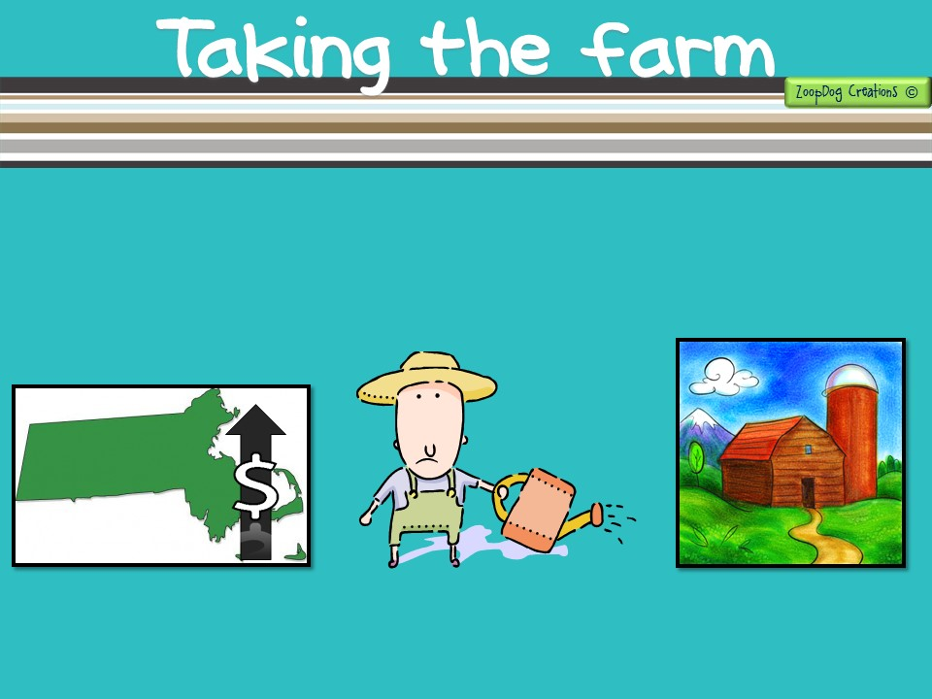
In Massachusetts matters worsened when the state raised taxes.
The courts seized the farms of those who could not pay their taxes or loans and threw some farmers in jail.
Angry farmers felt they were being treated unfairly!
The state of Massachusetts needs more money so it tells its citizens they need to pay more tax!
But Joe Farmer can barely pay what he owes to the bank, and has no money left to pay a higher tax to the state!
Joe Farmer loses his farm! He has no way of making ANY money now! He is angry!!!!

Slide 26
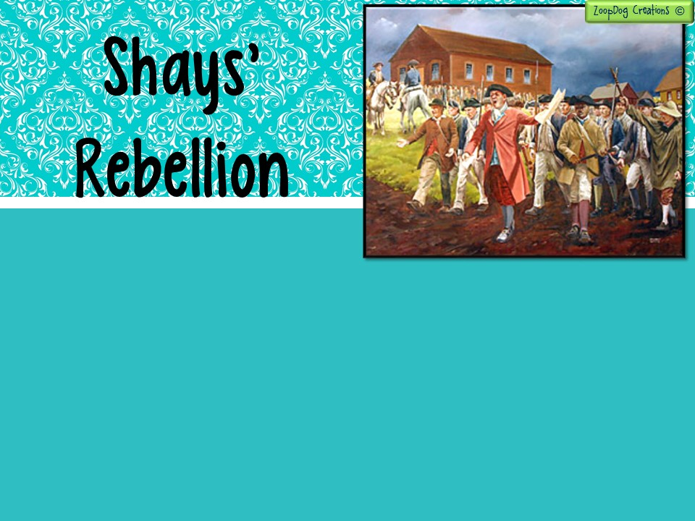
In 1786, Daniel Shays, a Massachusetts farmer who had fought at Bunker Hill and Saratoga, organized an uprising.
Nearly 2,000 mostly poor farmers took part in Shays’ Rebellion. They protested against their farms being seized and farmers who had been thrown in prison because they couldn’t pay their debt.
Daniel Shays thought this was unfair of his state and called on his government, (the weak federal government) to do something! But Congress didn’t have any power over the states!

Slide 27
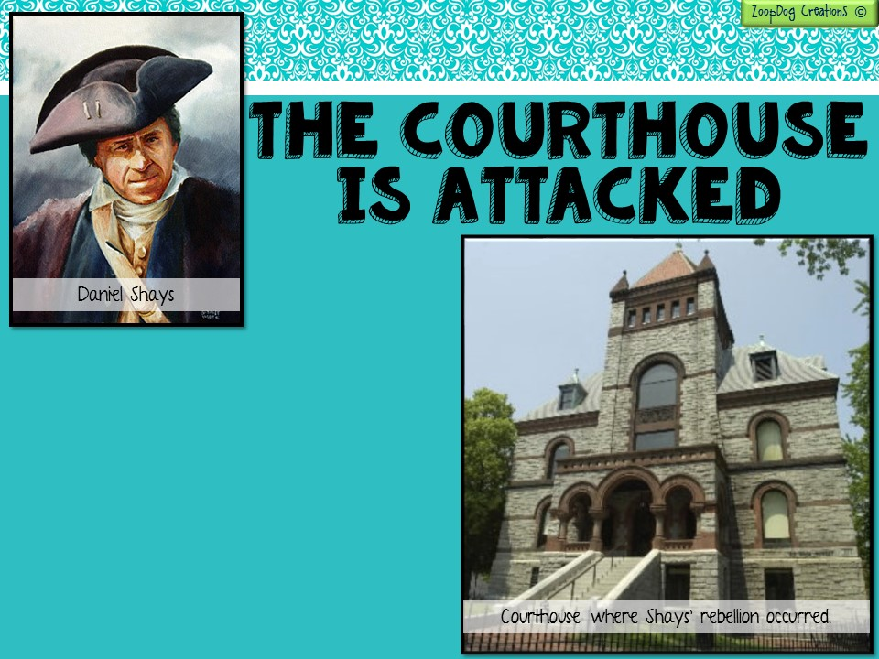
Shays attacked the courthouse and prevented the state from seizing farms.
He and his followers even tried to capture an arsenal filled with guns.
The Massachusetts legislature sent the militia to drive them off.

Slide 28
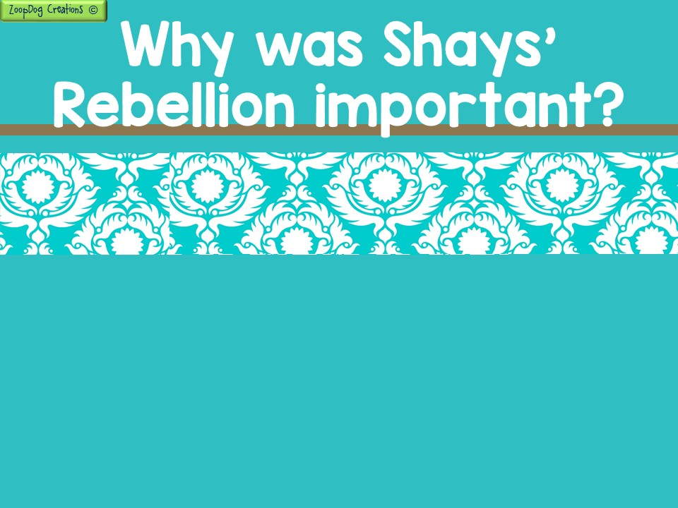
The rebellion showed that the all-powerful states could not rule alone. When left to their own devices some states taxed citizens unfairly - just as the British had done to them when they were colonists!
Each state’s paper money had become worthless, leading to an even greater economic depression!
Some historians believe Shays’ rebellion "fundamentally altered the course of the United States' history,” because it was proof that the Articles of Confederation did not work.

Slide 29
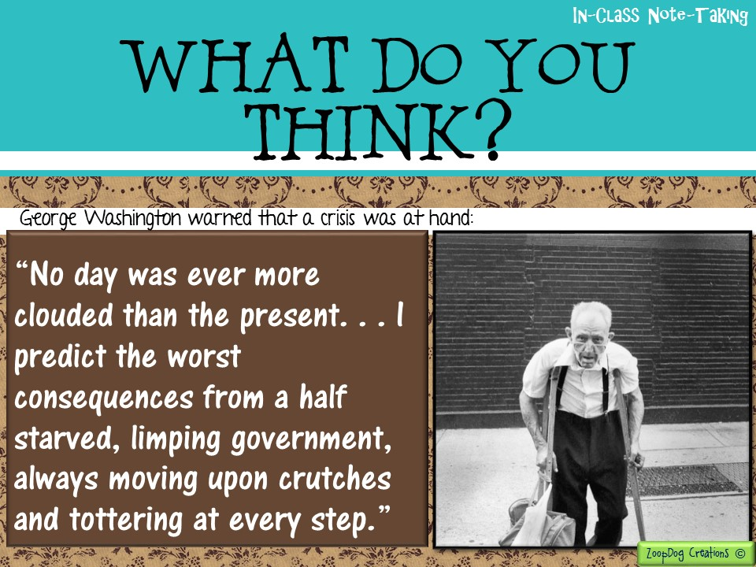

Slide 30
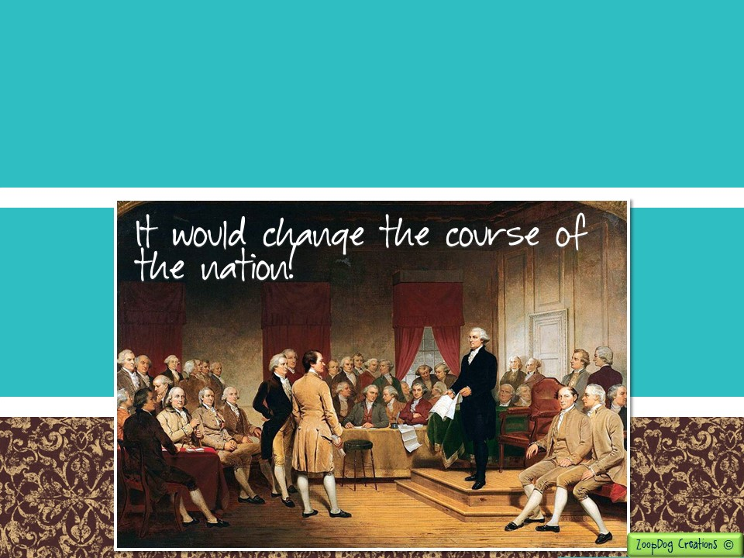
To avoid a crisis, leaders from several states called for a convention to revise the Articles of Confederation.
They decided to meet in Philadelphia in May, 1787.
In the end, however, this convention would do much more than just revise the Articles . . .

Slide 32
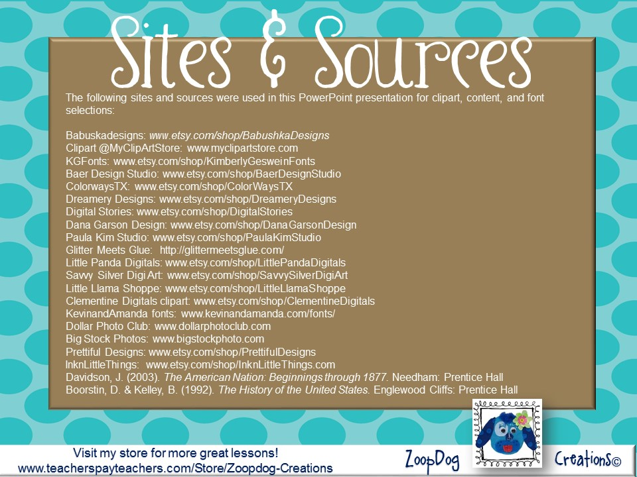

Slide 33
